Slide 1

Cllr Roy Perry
Leader Hampshire County Council

Slide 2


Slide 3
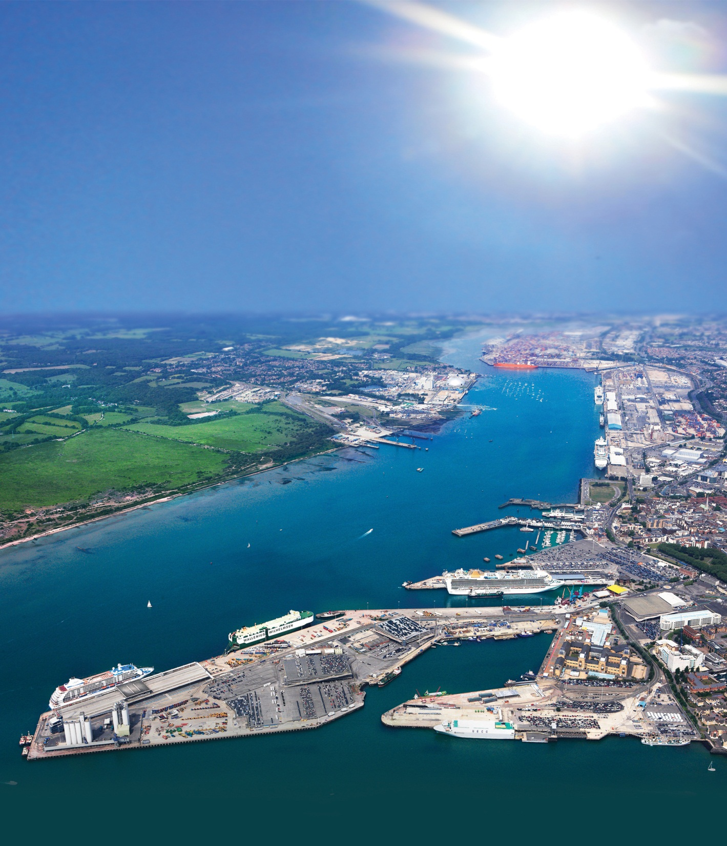
Devolution for the people of
Hampshire and the Isle of Wight
- Cllr Roy Perry
Leader of Hampshire CC
16th November 2015

Slide 4
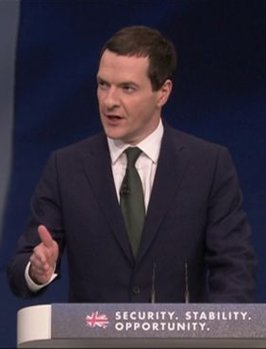



Context

Slide 5
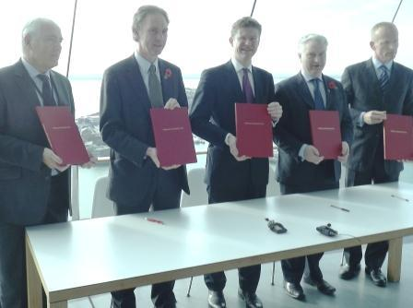
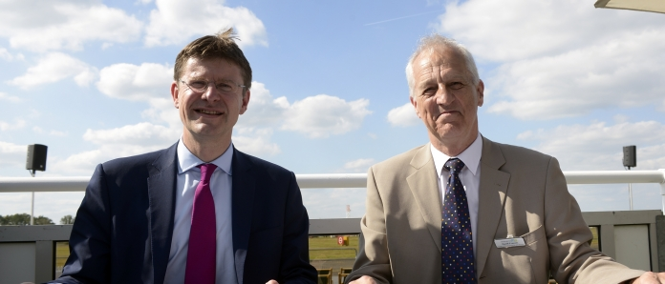
City Deal 2013
Growth Deals 2014
Devolution Deal 2015?

Slide 6
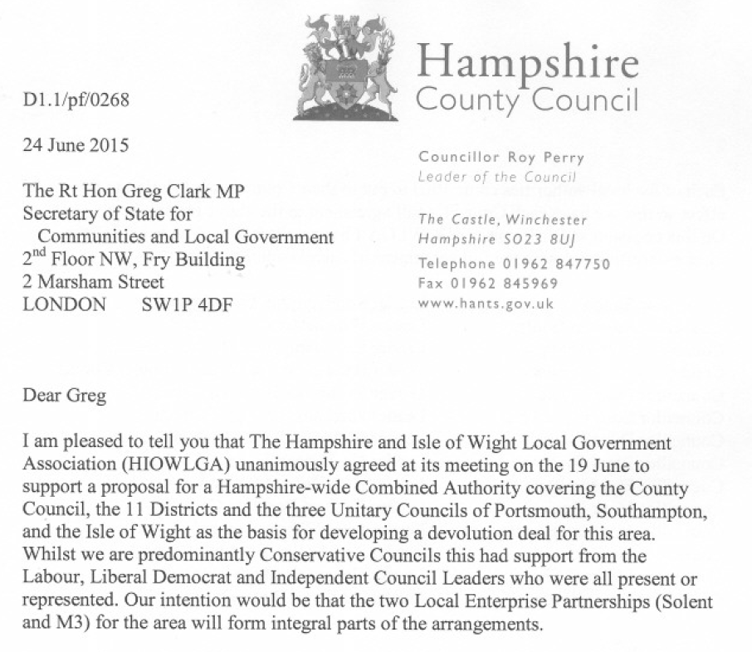

Slide 7
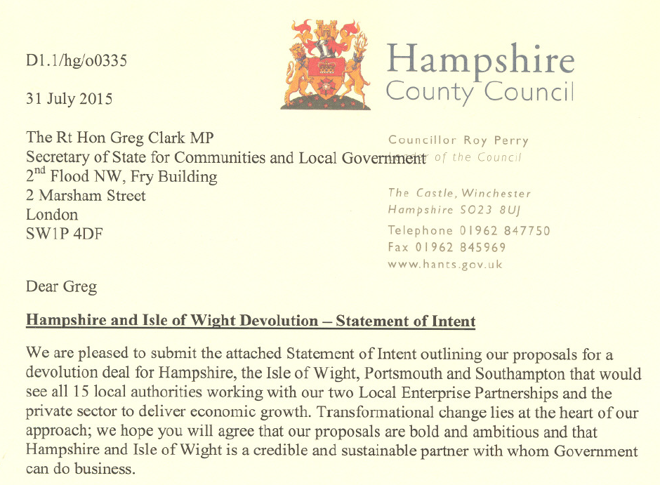

Slide 8
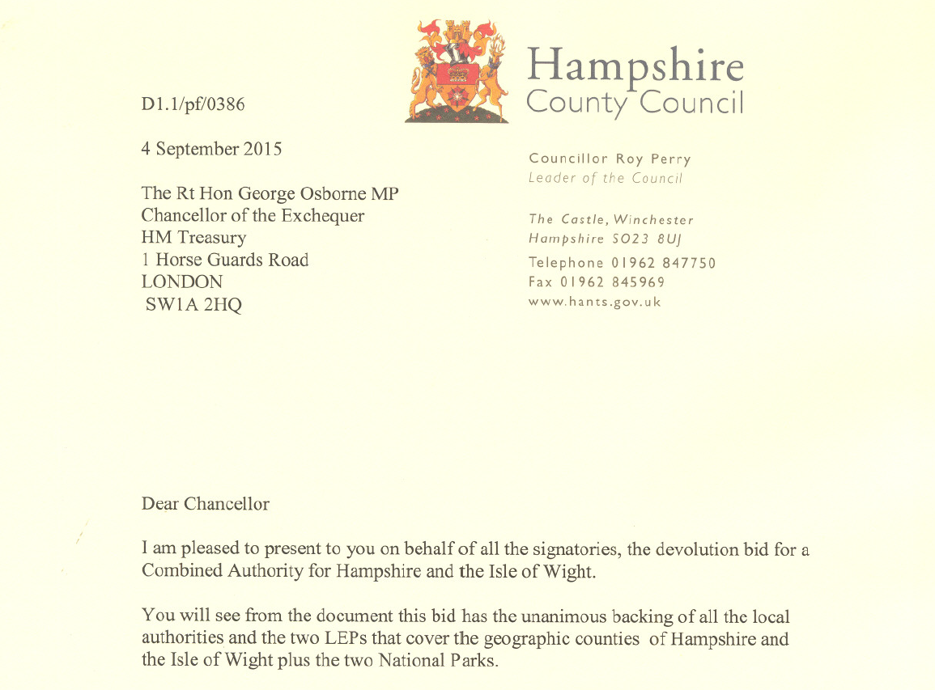

Slide 9

72 days!

Slide 10
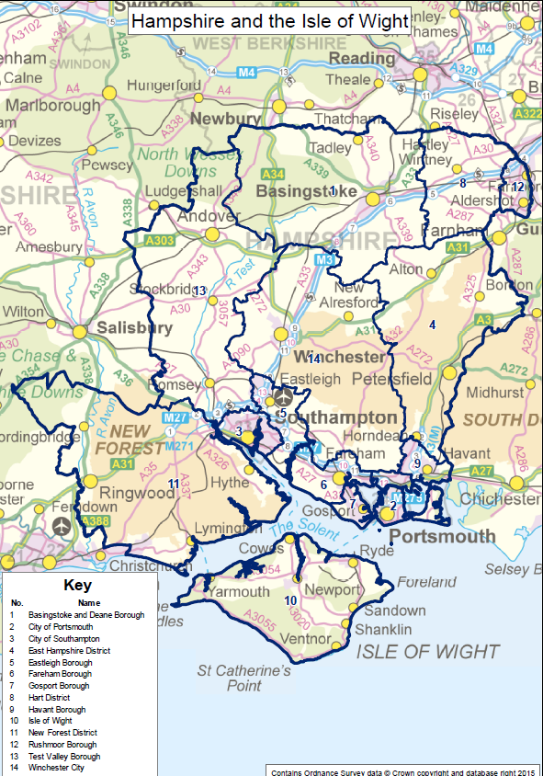
Geography
One county
One island
Two cities
Two LEPs
Two National Parks
Eleven districts
= 19 partners
2m residents
80,000 businesses
£47bn

Slide 11

The HIOW opportunity
Raise productivity to South East average:
a £3bn boost to UK plc

Slide 12

The HIOW bid
Implement 100% business rates retention from 2017 in Hampshire and Isle of Wight

Slide 13
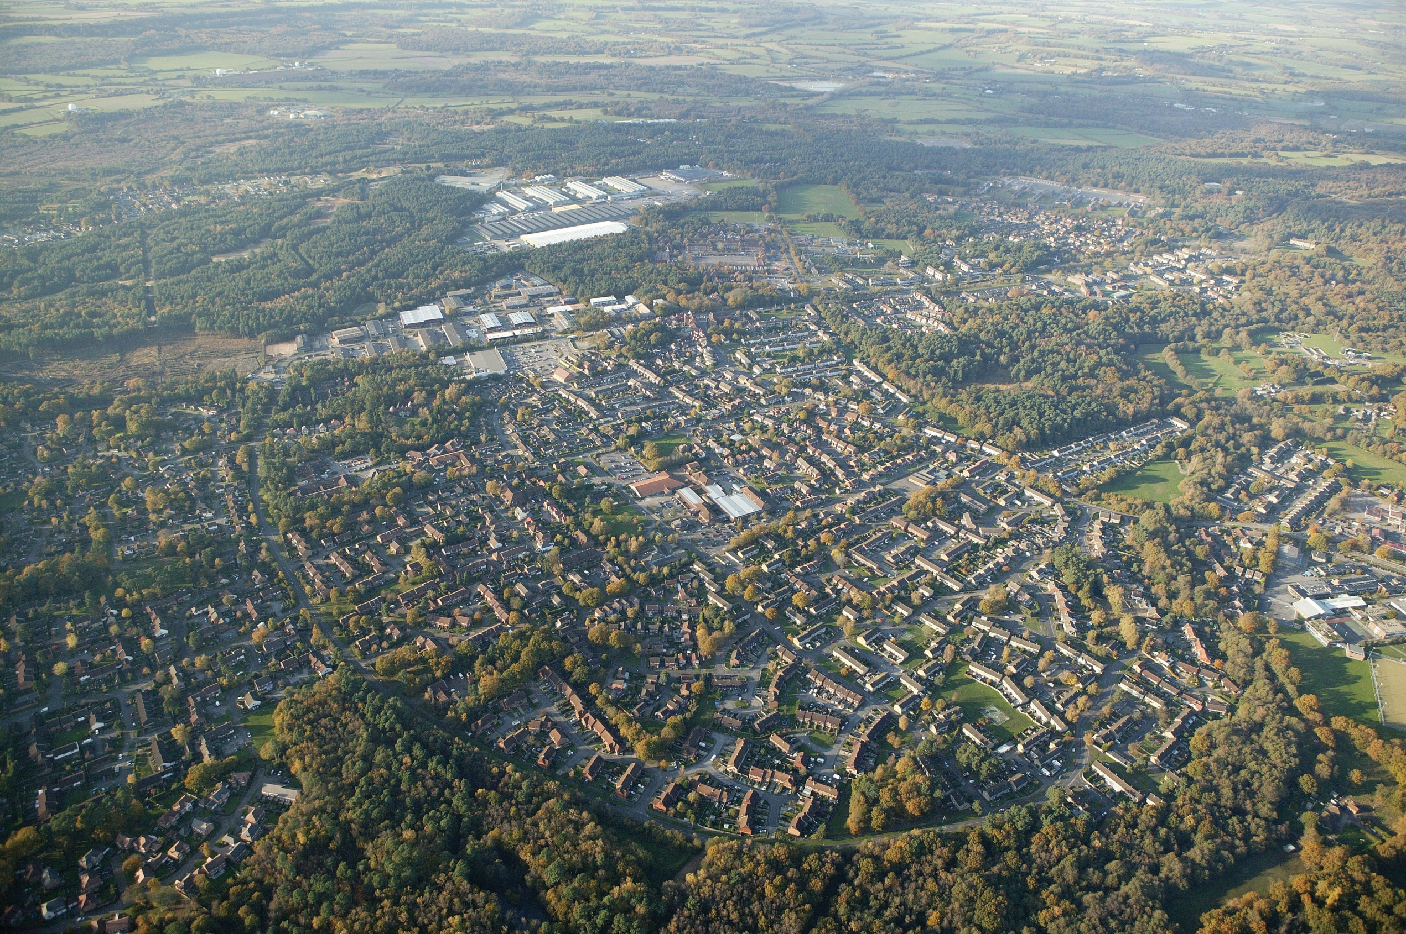
Earlier delivery of 76,000 homes -
and 4,000 more in priority categories

Slide 14
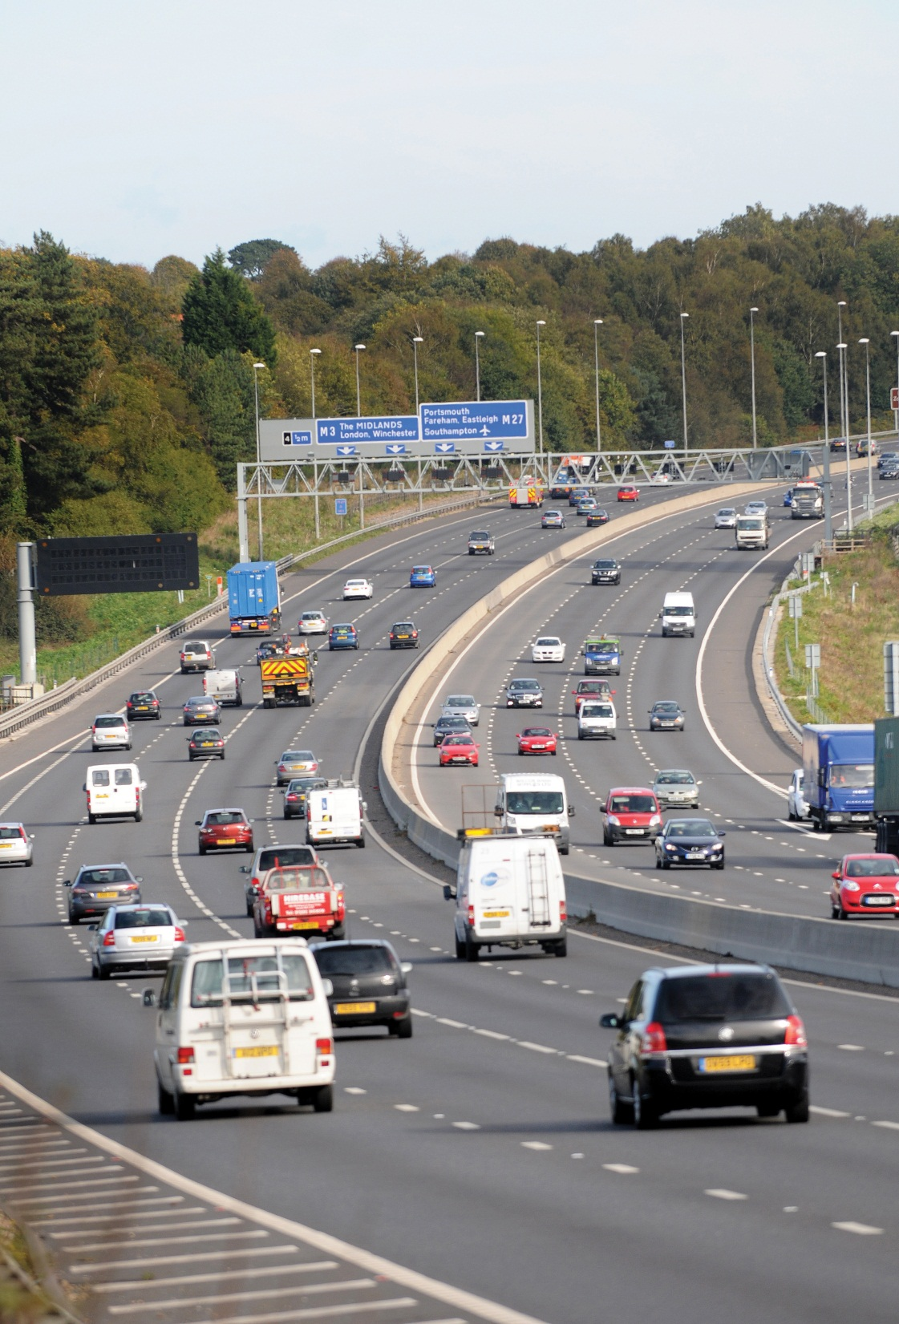
10-year certainty over infrastructure funding

Slide 15

Integrated business support, skills, training and welfare systems to support growth

Slide 16

Spreading the benefits of devolution

Slide 17

Commitment to a full governance review looking at all options

Slide 18
“Today I am embarking on the biggest transfer of power to our local government in living memory. We’re going to allow local government to keep the rates they collect from business. That’s right, all £26bn of business rates will be kept by councils instead of being sent up to Whitehall.”
George Osborne
5 October 2015
Notes:
“Today I am embarking on the biggest transfer of power to our local government in living memory. We’re going to allow local government to keep the rates they collect from business. That’s right, all £26bn of business rates will be kept by councils instead of being sent up to Whitehall.”
George Osborne
5 October 2015

Slide 19
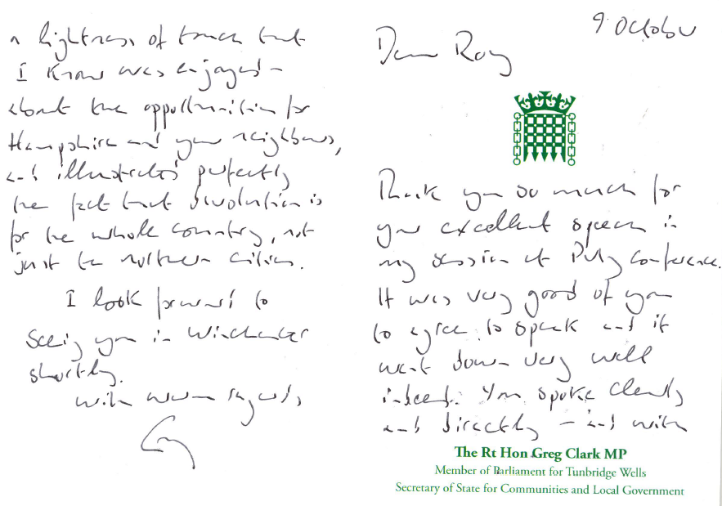

Slide 20

Questions?

