Slide 1
CCN/IPPR Governance Report Launch
Ed Cox
Chaired by Cllr Martin Hill

Slide 2
Empowering Counties: unlocking county devolution deals
Ed Cox
IPPR North
16 November 2015
@edcox_ippr

Slide 3
Some context …
A decentralisation decade?
Going beyond the cities … the Cities & Local Government Devolution Bill
4/9/15 and 38 on the starting line
From Cornwall to confusion
“As we recover from the recession and look to the future, it’s clear that for our country to succeed to the maximum extent possible, for us to fulfil our potential, every part of the country needs to be successful – not London alone”
Greg Clark MP

Slide 4
Why counties?
The bedrock of local democracy
86% landmass, half of the population
40% GVA // 26% business growth
Public service reform // social care challenges
County case studies:
Cornwall
Cheshire & Warrington
Hampshire & the Isle of Wight
East Midlands

Slide 5
Difficulties with Deal-making
The 4th September problem
The capacity problem
The silo problem and the role of HMT
The complexity problem– keeping people on board
The unwritten rules
Second-class citizens?

Slide 6
Some fundamental tensions
Economic growth vs public sector reform
Scale vs institutional identity
County vs district
Efficiency vs democracy
The spectre of metro-mayors

Slide 7
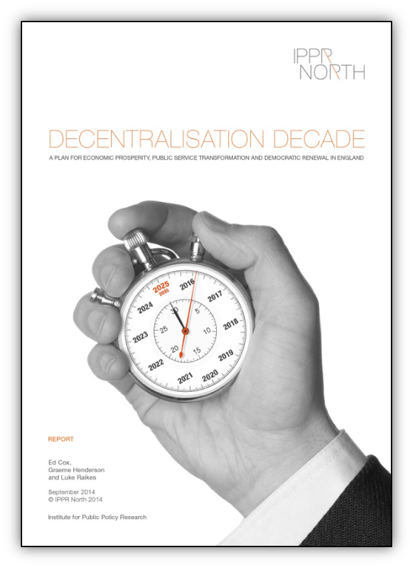
Charting a way forward: principles
A broad and clear purpose
A coherent and co-ordinate approach
Asymmetrical but not two-speed
Taking time
Cross-party collaboration

Slide 8
A broad and clear purpose
Driving economic development but not losing sight of public sector reform
Coterminosity with LEP boundaries
Review of role and remit of LEPs

Slide 9
Asymmetry and governance
Commitment to a range of models of governance
Combined authorities working together
Clarification of a ‘core settlement’
Conditions for metro-mayors
The importance of public visibility & accountability

Slide 11
Coherence and co-ordination
Streamlined capacity in government for deal-making
Clarification of process for negotiation and sign-off
Deal-making throughout this parliament
Milestones for negotiation
Support for ‘neighbouring deals’
Supporting collaboration and good practice

Slide 12
Supporting good practice
Sharing devo proposal and deals
Local authority networking
Training and support for councillors
Engagement with MPs
General models of county governance
Combined authority
County mayor and cabinet executive
Public service board
Federated model
Unitary model

