Slide 1
A New World of Finance:
Business Rates & Beyond
Margaret Lee
Chaired by Cllr David Borrow

Slide 2
A New World of Finance: Business Rates and Beyond
100% Business Rates Retention: What the announcement means for counties
Margaret Lee, SCT President

Slide 3
Key Issues for Counties
Risk and Reward
New Responsibilities
Needs Assessment and Redistribution
Reserves

Slide 4
Risk and Reward: The current system provides significant protection for shire counties’ income.
Shire Counties Income from Business Rates Retention | 2015-16
Revenue Support Grant | £2,350.68m
Baseline Funding Level | £2,420.30m
of which: Top Up Payments | £1,729.29m
Income from 20% Share | £691.01m
Additional Growth Retained | £19.36m
Total | £7,229.99m
In 2015-16, 86% of counties’ settlement funding assessment income is guaranteed, either through RSG or top-up payments
However, counties only receive an additional £19.36m (0.4% of SFA) as a reward for business rates growth
Districts received 15.6% of their SFA in additional growth
Notes:
On average RSG makes up 46% of local authorities settlement funding assessment (for 7 shire counties it represents over 50%: max. West Sussex 51.5%)

Slide 5
Risk and Reward: If the 80:20 split was made more equal, counties would be exposed to additional risk and greater reward
Currently in two-tier areas the split between counties’ and districts’ share of the SFA (their assessed need) is 84:16, i.e. a reversal of the current proportionate shares arrangement.
If the 80:20 split was reversed, to match the needs of upper-tier areas, county councils would be affected more significantly by fluctuations in business rates income (both positive and negative).
But, to what extent is it desirable that funding for services not directly linked to business growth is dependent on business growth?

Slide 6
New Responsibilities
In 2015-16 the settlement funding assessment is worth £20.8bn, of which £11.3bn is the local share of business rates and the remaining £9.5bn is Revenue Support Grant.
Under 100% business rates retention, local government is expected to gain an additional £11bn in business rates income. However this will be accompanied by the removal of Revenue Support Grant.
Over the period to 2020, public spending is likely to be cut by around 30% for unprotected departments, such as local government.
Given this trajectory and an estimated total of £26bn business rates, this provides scope for the Government to give LAs £3-4bn worth of additional responsibility to ensure reforms are ‘fiscally neutral’.

Slide 7
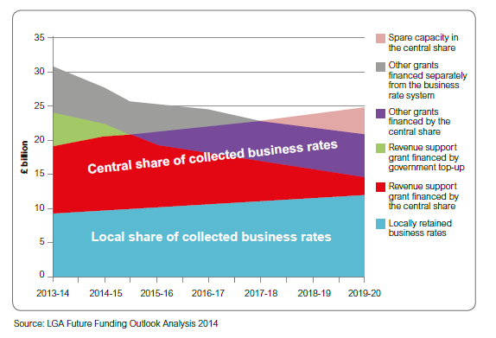
New Responsibilities: Funding Streams
New responsibilities to be funded from additional retained rates

Slide 8
New Responsibilities: Key Questions
Principles
What will the new responsibilities include?
Will new responsibilities be selected based on their ‘fit’ with business rates income? Should new responsibilities be linked to economic growth, e.g. commissioning skills?
For many local services demand does not necessarily match patterns of business rates income.
New Burdens
How will New Burdens be dealt with once full business rates retention is implemented?
Two-Tier Challenges
In two-tier areas demographic growth impacts on each tier in differing ways. In particular, how will demographic growth pressures be funded, especially those linked social care, given a more opaque link to business rates?

Slide 9
Needs Assessment and Redistribution
Two-tier areas currently generate 32% of total national business rates income and receive 27% of the overall Settlement Funding Assessment.
Based on the current forecasts for business rates income, if 100% of rates were retained by local authorities in 2015-16, 21 out of 27 two-tier areas would be self- sufficient and would generate a surplus of business rates compared to their allocation of formula funding.
In 2015-16, two-tier areas would have generated a surplus of £1.8bn above their current needs assessment.
In the new system, patterns of redistribution will depend on the new needs formula, to be consulted on as part of the reforms.
Under the existing rates retention scheme, a new needs assessment was expected to take place in 2020. This is still expected to take place, to form the basis of the start-up position for the new scheme.

Slide 10
Needs Assessment and Redistribution: Priorities for Counties
A new needs assessment and system of redistribution must enable all LAs to adequately fund core services on a stable basis.
The current redistribution system, which determines the settlement funding assessment and top-ups and tariffs, is based on historic need. It does not take account of forecast changes in population size and characteristics.
Need assessment is based on need at a single point in time – therefore the period between resets is important: a balance between stability and responsiveness.
Rapidly growing areas argue the need assessment does not reflect current demand and funding fails to keep pace with their need.
Counties’ elderly populations are growing faster than other types of authority, however, the current formula still gives significant weighting to deprivation within the adult social care needs assessment.

Slide 11
Reserves
In response to funding cuts, local authorities’ reserves have increased in recent years, to manage greater risk. Recent decisions on valuations for certain types of properties have resulted in large refunds of business rates.
This risk is likely to increase significantly under a system of full rates retention and will be managed through reserves.
Many NHS trusts are currently running deficits, as they are not able to hold reserves in the same way as local authorities; consequently, the Government is facing demands for cash injections in-year.
The Government must recognise councils should be able to set aside sufficient reserves to enable a prudent approach to managing volatility, without facing criticism from Ministers on levels of reserves and pressure to reduce balances.

Slide 12
Summary
Risk and Reward
Counties are relatively protected in the current business rates system through top-ups and RSG payments. If the 80:20 split was made more equal, counties would be exposed to more risk, but would have the potential for greater reward .
New Responsibilities
If counties could secure new powers linked to commissioning skills and support for business, the business rate system could become more responsive to businesses’ needs. Demand for other types of new responsibilities may not necessarily grow in line with business rates growth.
Needs Assessment and Redistribution
Overall, county areas collect significantly more business rates than their assessed need. However, some aspects of the current formula fail to reflect the needs of counties and rapidly growing areas. A new formula is an opportunity to address this and will determine levels of redistribution.
Reserves
Councils must be able manage the increased risk of full rates retention effectively through appropriate levels of reserves, which for some counties will be significant, in cash terms.

