Slide 1
Voluntary Sector Partnerships: Local Works
Paul Streets OBE
Chief Executive, Lloyds Bank Foundation for England and Wales

Slide 2
Voluntary Sector Partnerships:
Local works
Paul Streets
November 2019
Notes:
Plain title slide – option one. You only need one title slide per presentation!

Slide 3
Smaller charities are distinctive
What they do (and for whom)
How they do it
Where they do it
The Value of Small
Notes:
Act as ‘first responders’ to people in crisis
Create spaces where people feel safe and respected, without fear of being stigmatised
Promote inclusion and belonging by connecting new and established communities to wider opportunities and support
Culturally sensitive
Support in different languages
Connect new and established communities to opportunities
Take a person-centred approach, built on long-lasting relationships of trust, creating conditions for long-term engagement
Embedded in and trusted by our communities
Reach people early and stay with them for the long term
Have an open door approach, meaning that people are not turned away and are listened to without fear of judgement
Can make quick decisions
Volunteers and staff reflect the diversity of our local community
Trust and long-term engagement
Diversity that reflects the community
Are well-established within and between local networks; strong local relationships
Advocate for people in need of support
Are the ‘glue’ that holds communities together

Slide 4
Distinctiveness
These three features are often found in combination...
...and lead to services and activities that are additional to other providers... ...so smaller charities often add up to more than the sum of their parts
The Value of Small

Slide 5
Small charities generate value
Economic value
Individual value
Added value
Value to the economy
Economic value of outcomes, including to public services
Meeting basic and unmet needs
'Soft' personal, social and emotional outcomes
'Hard' more tangible outcomes
The cross-cutting value of volunteering
Funding sources and leverage
Embeddedness in local organisational and social networks
Notes:
Bringing in additional funding
Investing money locally
Driving down demand for other public services
Employing local people
The cross-cutting value of volunteering
Funding sources and leverage
Embeddedness in local organisational and social networks
Insights for commissioners
History

Slide 6
Delivering services that matter
County Councils
Mental health
District Councils
Adult social care
Homelessness
Care leavers
Education
Learning disability
Domestic abuse
Supported housing
Children’s social care
Sport & leisure
Substance misuse
Local welfare support

Slide 7
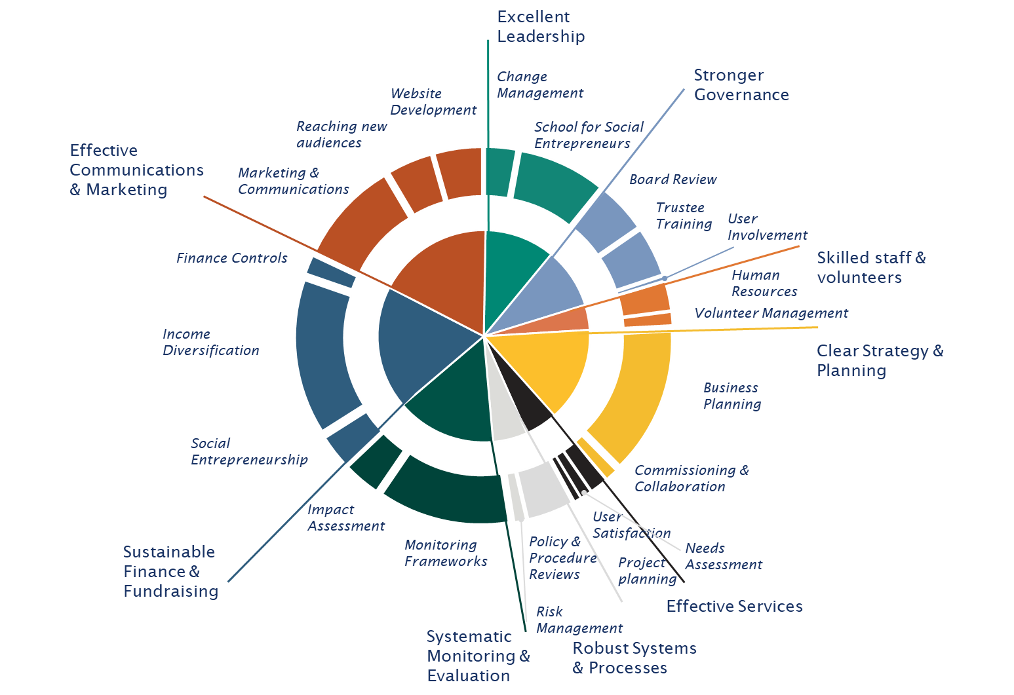
Scale & reach
#FunderPlus
Notes:
- Work with an approved supplier list
- Callout a group of our national providers (SSE, NCVO, Eastside Primetimers, Cranfield Trust, Ethical Property Foundation, Computer Recyclers etc)

Slide 8
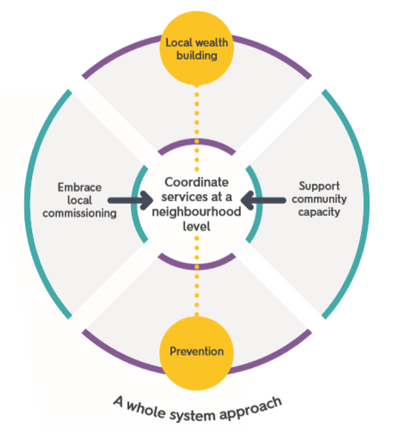
Keep it Local

Slide 9
Thinking local is spreading
The Government needs to ensure that the market for Government contracts remains contestable from within the public sector, from existing companies and new entrants. We welcome the Minister’s commitments in this area and we await to see in the Government’s response details on its new measures to increase small and medium sized enterprises’ participation in the market.
Public and Constitutional Affairs Committee, Outsourcing & Contracts
“In commissioning services and interventions, we will engage directly with smaller providers who can often provide a more tailored and locally responsive approach”
Ministry of Justice, Blueprint for probation

Slide 10
Paul Streets

